Slide 1
CS412
Information Retrieval

Slide 2
GCR Code: wzmuvnv
Email: safia.Baloch@giki.edu.pk
Office.

Slide 3
About Course
Marks distribution
Final=40
Mid Term=30
Project=12
Assignment=3*4=12
Quiz=3 * 2=6

Slide 4
Introduction of Course
What is IR?
What is Large language Model?
What is Natural Language Model?
What is Natural Language Inference?
What is Natural Language Understanding ?
Why should you use ChatGPT or model app like it?

Slide 5
Use chatgpt & answer the following
What is the difference between retrieval, predictive, and generative model ?

Slide 6
Basic Assumption for IR
Furnish User information need from a collection of documents
Query correction/refinement
IR evaluation
Precision: fraction of relevant doc to user query
Recall: fraction of relevant docs in collection that are retrieved

Slide 7
IR Problem
Q: which plays of Shakespeare contain the words Brutus AND Caesar but NOT Calpurnia ?
First solution : “grep”
Grep is Not the answer :
Growing online data collection with billion and trillions of words. slow
Impractical to perform query Romans Near(within the same sentence ) countrymen
Ranked retrieval (best documents to return)
making good document is the answer

Slide 8
Boolean Retrieval Model
The Boolean retrieval model is a model for information retrieval in which we MODEL can pose any query which is in the form of a Boolean expression of terms, that is, in which terms are combined with the operators AND, OR, and NOT. The model views each document as just a set of words
Corpus= body of texts
Document= content(book, chapter etc.) that RS is built over

Slide 9
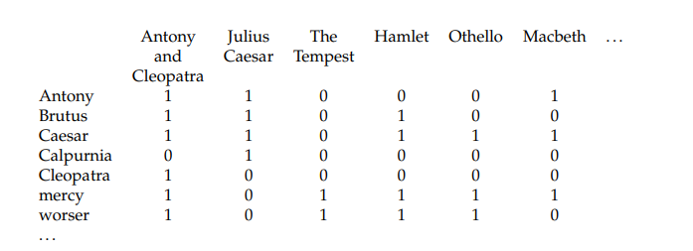
Term Document Incidence Matrix(Document representation)
Query: Brutus AND Caesar but NOT Calpurnia

Slide 10
Query: Brutus AND Caesar but NOT Calpurnia

Slide 11
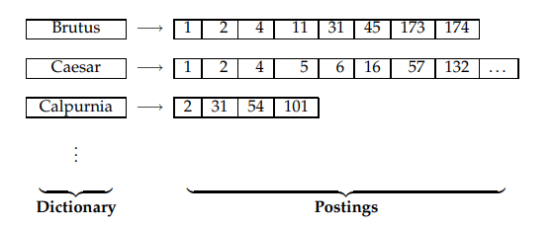
Inverted Index
Index maps to terms to the part of a document where they occur.
Inverted Index is having dictionary: data structure(lexicon, vocabulary: set of terms) and list with information of document that term appeared.
Dictionary
Posting list

Slide 12
Building Inverted Index/index compression
Collect the documents to be indexed, give a unique DocID
Tokenize the text, turning each document into a list of tokens
Do linguistic preprocessing, producing list of normalizing tokens,
Index the documents that each term occurs in by creating an inverted index, consisting of a dictionary and postings.
Sorting alphabetically
Multiple occurrences of the same term from same document is merged

Slide 13
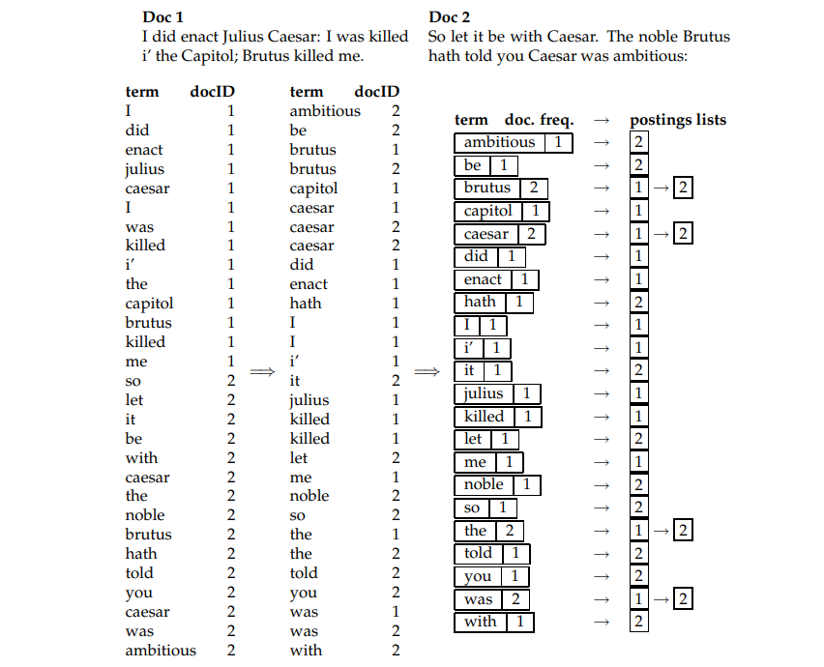
Example

Slide 14
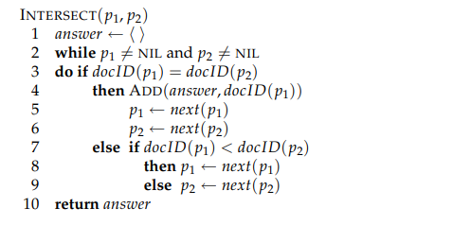
Process Boolean Query using Inverted Index and Boolean Retrieval Model
Locate Brutus in the Dictionary
Retrieve its postings
Locate Calpurnia in the Dictionary
Retrieve its postings
Intersect the two postings lists (crucial operation)

Slide 15
Query: Brutus AND Calpurnia

Slide 16

Recall the basic indexing pipeline
Documents to
be indexed
Friends, Romans, countrymen.
Tokenizer
Token stream
Friends
Romans
Countrymen
Linguistic modules
Modified tokens
friend
roman
countryman
Indexer
friend
2
4
roman
1
2
Inverted index
countryman
13
16
Notes:
Circle documents

Slide 17
Parsing a document
Sec. 2.1
What format is it in?
pdf/word/excel/html?
What language is it in?
What character set is in use?
(CP1252, UTF-8, …)

Slide 18
Complications: Format/language
Sec. 2.1
Documents being indexed can include docs from many different languages
A single index may contain terms from many languages.
Sometimes a document or its components can contain multiple languages/formats
French email with a German pdf attachment.
French email quote clauses from an English-language contract
Notes:
Nontrivial issues. Requires some design decisions.

Slide 19
Complications: What is a document?
Sec. 2.1
We return from our query “documents” but there are often interesting questions of grain size:
What is a unit document?
A file?
An email? (Perhaps one of many in a single mbox file)
What about an email with 5 attachments?
A group of files (e.g., PPT or LaTeX split over HTML pages)
Token/Term?
Notes:
Nontrivial issues. Requires some design decisions.

Slide 20
Tokenization
Sec. 2.2.1
Input: “Friends, Romans and Countrymen”
Output: Tokens
Friends
Romans
Countrymen
A token is an instance of a sequence of characters
Each such token is now a candidate for an index entry, after further processing
But what are valid tokens to emit?

Slide 21
Tokenization
Sec. 2.2.1
Issues in tokenization:
Finland’s capital →
Finland AND s? Finlands? Finland’s?
Hewlett-Packard → Hewlett and Packard as two tokens?
state-of-the-art: break up hyphenated sequence.
co-education
lowercase, lower-case, lower case ?
It can be effective to get the user to put in possible hyphens
San Francisco: one token or two?
How do you decide it is one token?

Slide 22
Numbers
Sec. 2.2.1
3/20/91 Mar. 12, 1991 20/3/91
55 B.C.
B-52
My PGP key is 324a3df234cb23e
(800) 234-2333
Often have embedded spaces
Older IR systems may not index numbers
But often very useful: think about things like looking up error codes/stacktraces on the web
Will often index “meta-data” separately
Creation date, format, etc.

Slide 23
Tokenization: language issues
Sec. 2.2.1
Chinese and Japanese have no spaces between words:
莎拉波娃现在居住在美国东南部的佛罗里达。
Not always guaranteed a unique tokenization
Further complicated in Japanese, with multiple alphabets intermingled
Dates/amounts in multiple formats
Arabic (or Hebrew) is basically written right to left, but with certain items like numbers written left to right
フォーチュン500社は情報不足のため時間あた$500K(約6,000万円)
Katakana
Hiragana
Kanji
Romaji
End-user can express query entirely in hiragana!

Slide 24
Stop words
Sec. 2.2.2
With a stop list, you exclude from the dictionary entirely the commonest words. Intuition:
They have little semantic content: the, a, and, to, be
There are a lot of them: ~30% of postings for top 30 words
But the trend is away from doing this:
Good compression techniques means the space for including stop words in a system is very small
Good query optimization techniques mean you pay little at query time for including stop words.
You need them for:
Phrase queries: “King of Denmark”
Various song titles, etc.: “Let it be”, “To be or not to be”
“Relational” queries: “flights to London”
Notes:
Nevertheless: “Google ignores common words and characters such as where, the, how, and other digits and letters which slow down your search without improving the results.” (Though you can explicitly ask for them to remain.)

Slide 25
Normalization to terms
Sec. 2.2.3
We may need to “normalize” words in indexed text as well as query words into the same form
We want to match U.S.A. and USA
Result is terms: a term is a (normalized) word type, which is an entry in our IR system dictionary
We most commonly implicitly define equivalence classes of terms by, e.g.,
deleting periods to form a term
U.S.A., USA ⎝ USA
deleting hyphens to form a term
anti-discriminatory, antidiscriminatory ⎝ antidiscriminatory
For other Languags
Even in languages that standardly have accents, users often may not type them
Often best to normalize to a de-accented term
Tuebingen, Tübingen, Tubingen ⎝ Tubingen

Slide 26
Lemmatization
Sec. 2.2.4
Reduce inflectional/variant forms to base form
E.g.,
am, are, is → be
car, cars, car's, cars' → car
the boy's cars are different colors → the boy car be different color
Lemmatization implies doing “proper” reduction to dictionary headword form

Slide 27
Example: WestLaw http://www.westlaw.com/
Sec. 1.4
Largest commercial (paying subscribers) legal search service (started 1975; ranking added 1992; new federated search added 2010)
Tens of terabytes of data; ~700,000 users
Majority of users still use boolean queries
Example query:
What is the statute of limitations in cases involving the federal tort claims act?
LIMIT! /3 STATUTE ACTION /S FEDERAL /2 TORT /3 CLAIM
/3 = within 3 words, /S = in same sentence

Slide 28
Example: WestLaw http://www.westlaw.com/
Sec. 1.4
Another example query:
Requirements for disabled people to be able to access a workplace
disabl! /p access! /s work-site work-place (employment /3 place
Note that SPACE is disjunction, not conjunction!
Long, precise queries; proximity operators; incrementally developed; not like web search
Many professional searchers still like Boolean search
You know exactly what you are getting
But that doesn’t mean it actually works better….

Slide 29
Query optimization
Sec. 1.3
What is the best order for query processing?
Consider a query that is an AND of n terms.
For each of the n terms, get its postings, then AND them together.
Brutus
2
4
8
16
32
64
128
Caesar
1
2
3
5
8
16
21
34
Calpurnia
13
16
Query: Brutus AND Calpurnia AND Caesar
29

Slide 30
Query optimization example
Sec. 1.3
Process in order of increasing freq:
start with smallest set, then keep cutting further.
This is why we kept
document freq. in dictionary
Brutus
2
4
8
16
32
64
128
Caesar
1
2
3
5
8
16
21
34
Calpurnia
13
16
Execute the query as (Calpurnia AND Brutus) AND Caesar.
If the query is friends AND romans AND (NOT countrymen), how could we use the freq of countrymen?

Slide 31
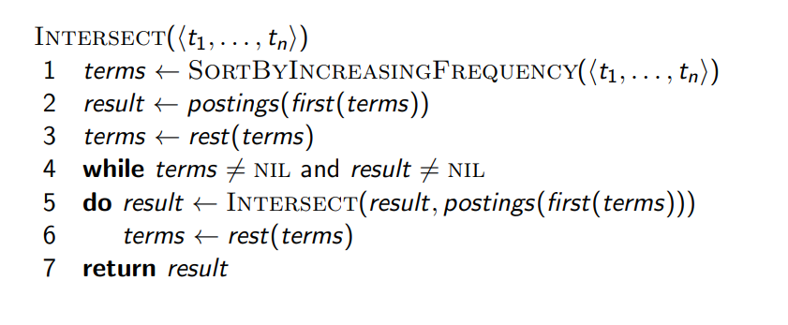
Optimized intersection algorithm for conjunctive queries Optimized intersection algorithm for conjuction

Slide 32
Phrase queries
Sec. 2.4
We want to be able to answer queries such as “stanford university” – as a phrase
The inventor Stanford Ovshinsky never went to university should not be a match
10% of web queries = phrase queries
Thus the sentence “I went to university at Stanford” is not a match.
The concept of phrase queries has proven easily understood by users; one of the few “advanced search” ideas that works
Many more queries are implicit phrase queries
For this, it no longer suffices to store only: <term : docs> entries
Extending inverted Index
Biword index
Positional index

Slide 33
A first attempt: Biword indexes
Sec. 2.4.1
Index every consecutive pair of terms in the text as a phrase
Example
For Document: “Friends, Romans, Countrymen”
Text would generate the biwords
friends romans
romans countrymen
Each of these biwords is now a dictionary term
Two-word phrase query-processing is now immediate.

Slide 34
Longer phrase queries
Sec. 2.4.1
Longer phrases can be processed by breaking them down
stanford university palo alto can be broken into the Boolean query on biwords:
stanford university AND university palo AND palo alto
Without the docs, we cannot verify that the docs matching the above Boolean query do contain the phrase.
False positives. we need to do post-filtering of hits to identify subset that actually contains the 4-word phrase.
Can have false positives!

Slide 35
Issues for biword indexes
Sec. 2.4.1
False positives, as noted before
Index blowup due to bigger dictionary
Infeasible for more than biwords, big even for them
Biword indexes are not the standard solution (for all biwords) but can be part of a compound strategy

Slide 36
Solution 2: Positional indexes
Sec. 2.4.2
Posting list in a nonpositional index?
In the postings, store, for each term the position(s) in which tokens of it appear:
<term, number of docs containing term;
doc1: position1, position2 … ;
doc2: position1, position2 … ;
etc.>

Slide 37
Positional index example
Sec. 2.4.2
<be: 993427;
1: 7, 18, 33, 72, 86, 231;
2: 3, 149;
4: 17, 191, 291, 430, 434;
5: 363, 367, …>
Which of docs 1,2,4,5
could contain “to be
or not to be”?
For phrase queries, we use a merge algorithm recursively at the document level
But we now need to deal with more than just equality

Slide 38
Processing a phrase query
Sec. 2.4.2
Extract inverted index entries for each distinct term: to, be, or, not.
Merge their doc:position lists to enumerate all positions with “to be or not to be”.
to:
2:1,17,74,222,551; 4:8,16,190,429,433; 7:13,23,191; ...
be:
1:17,19; 4:17,191,291,430,434; 5:14,19,101; ...
Same general method for proximity searches

Slide 39
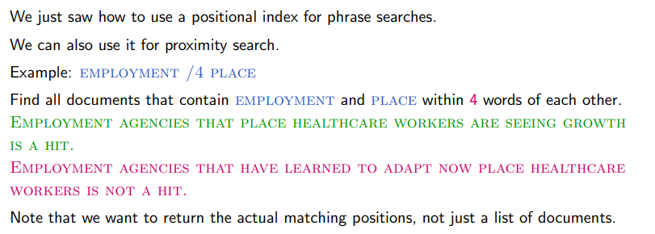
Proximity Search

Slide 40
Proximity queries
Sec. 2.4.2
LIMIT! /3 STATUTE /3 FEDERAL /2 TORT
Again, here, /k means “within k words of”.
Clearly, positional indexes can be used for such queries; biword indexes cannot.
Exercise: Adapt the linear merge of postings to handle proximity queries. Can you make it work for any value of k?
This is a little tricky to do correctly and efficiently
See Figure 2.12 of IIR

Slide 41
Positional index size
Sec. 2.4.2
A positional index expands postings storage substantially
Even though indices can be compressed
Nevertheless, a positional index is now standardly used because of the power and usefulness of phrase and proximity queries … whether used explicitly or implicitly in a ranking retrieval system.

Slide 42
Positional index size
Sec. 2.4.2
Need an entry for each occurrence, not just once per document
Index size depends on average document size
Average web page has <1000 terms
SEC filings, books, even some epic poems … easily 100,000 terms
Consider a term with frequency 0.1%
Why?
Document size
Postings
Positional postings
1000
1
1
100,000
1
100

Slide 43
Rules of thumb
Sec. 2.4.2
A positional index is 2–4 as large as a non-positional index
Positional index size 35–50% of volume of original text
Caveat: all of this holds for “English-like” languages

Slide 44
Combination schemes
Sec. 2.4.3
These two approaches can be profitably combined
For particular phrases (“Michael Jackson”, “Britney Spears”) it is inefficient to keep on merging positional postings lists
Even more so for phrases like “The Who”
Williams et al. (2004) evaluate a more sophisticated mixed indexing scheme
A typical web query mixture was executed in ¼ of the time of using just a positional index
It required 26% more space than having a positional index alone

Slide 45
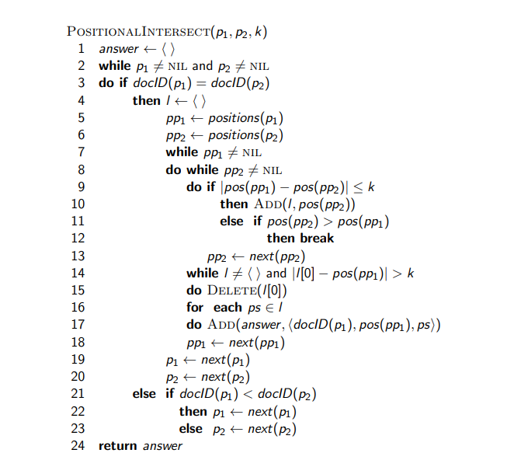
Proximity Intersection

Slide 46
What does Google do? And Write examples for Urdu Language
Stop words
Normalization
Tokenization
Lowercasing
Stemming
Non-latin alphabets
Compounds
Numbers

Slide 47
Skim the paper
Understanding Differential Search Index for Text Retrieval by Xiaoyang Chen et al

